Slide 1
nDP UNIT
STRATEGY / KPI PLANNING & Alignment
24 Feb 2014

Slide 2
Agenda
Time | Activity | Lead
12pm – 12:30pm | Welcome & Purpose [Finger Lunch from “Mr Nandos”] | David
12:30pm –1 :30pm | Directors Reports and Q&A | Collins Lee Suzette Douglas
1:30pm – 3:30pm | Strategy / KPI Alignment [Tea and Coffee] | All Douglas as Facilitator
3:30pm – 4pm | Wrap Up | David

Slide 3
Session I: Welcome & Purpose
The session is still a strategic planning session and not a project nor operational meetings (the aim is not be repeat the purpose of existing meetings)
It is a reflection back on 2013/14 and view forward to 2014/15 using the alignment of Strategy and the KPI’s as the filtering instrument
It an opportunity to share lessons learnt, priorities for the future and to engage in debate (on constructive ideas rather than issues)
You all have the platform, there are no rules or expectations, but you neeed engage

Slide 4
Session II: Directors Reports
Collins
Lee
Suzette
Douglas

Slide 5
"However beautiful the strategy, you should occasionally look at the results."
Winston Churchill

Slide 6
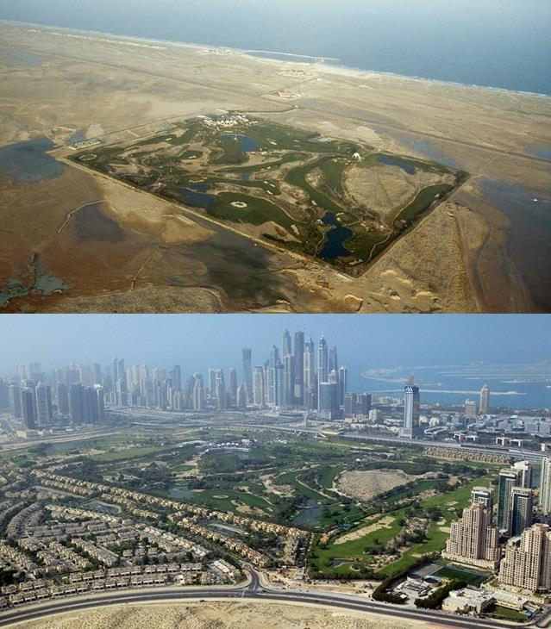
Emirates Golf Club in 1991
13 years
Emirates Golf Club in 2014

Slide 7
Session III Strategy & KPI Alignment
“A metric that helps you understand how you are doing against your objectives.”
        Avinash Kaishik
“A KPI: 1) Echoes organisation goals, 2) is decided by management, 3) provides context, 4) creates meaning on all levels of the all organizational levels, 5) is based on legitimate data, 6) is easy to understand and 7) leads to action!”
        Dennis Mortensen

Slide 8
NDP’s Key Performance Indicators (KPI’s)
SOURCE
ENE / AENE
NT Strategic Plan NT Annual Report (APP)
NT Annual Report
NDP Business Plan (New)
Programme Performance
Grant Financial Performance
Urban Network Strategy Performance

Slide 9
NDP’s Key Performance Indicators (KPI’s)
SOURCE
ENE / AENE
NT Strategic Plan NT Annual Report (APP)
NT Annual Report
NDP Business Plan (New)
KPA
Programme Planning
Project Implementation
Catalytic Leverage
Estab. of UNS
Precinct Planning
Well Managed Hubs
Stakeholder Engagement
KPI
Total number of neighbourhood development partnership projects granted award status
Total number of neighbourhood development partnership projects under construction
Number of long-term township regeneration programmes implemented per year
Third party investment leverage per year
KPA
Establishment of Urban Networks Strategy
Programme Planning
Precinct Plans*
Precinct Management*
Leverage*
Project Delivery*
Rural Handover
Programme Performance

Slide 10
NDP’s Key Performance Indicators (KPI’s)
SOURCE
ENE / AENE
NT Strategic Plan NT Annual Report (APP)
NT Annual Report
NDP Business Plan (New)
KPA
Programme Planning
Project Implementation
Catalytic Leverage
Estab. of UNS
Precinct Planning
Well Managed Hubs
Stakeholder Engagement
KPI
Total number of long-term urban regeneration programmes registered No of NDP Awards Funded
Total number of neighbourhood development partnership projects approved (cumulative) No of NDP Projects Approved
Number of NDPG projects under construction
Estimated third party investment leveraged (cumulative)

Slide 11
NDP’s Key Performance Indicators (KPI’s)
SOURCE
ENE / AENE
NT Strategic Plan NT Annual Report (APP)
NT Annual Report
NDP Business Plan (New)
KPA
Programme Planning
Project Implementation
Catalytic Leverage
Estab. of UNS
Precinct Planning
Well Managed Hubs
Stakeholder Engagement
KPI
Expenditure (Technical Assistance) (Rm)
Expenditure (Capital Grant) (Rm)
Expenditure (NDPG Total) (Rm)
Grant Financial Performance

Slide 12
NDP’s Key Performance Indicators (KPI’s)
SOURCE
ENE / AENE
NT Strategic Plan NT Annual Report
NT Annual Report (APP)
NDP Business Plan (New)
KPA
Programme Planning
Project Implementation
Catalytic Leverage
Estab. of UNS
Precinct Planning
Well Managed Hubs
Stakeholder Engagement
KPI
Total number of executive engagements completed (Council Res / MOA)
Total number of approved / revised Urban Network Plans (cumulative)
Total number of approved Precinct Plans (Urban Hubs) (cumulative)
No of approved projects in construction (as % of gazette)
Total number of Precincts (Urban Hubs) Commenced
Total number of Partnerships concluded
Financial Leverage
Urban Network Strategy Performance

Slide 13
NDP’s Key Performance Indicators (KPI’s)
Targets
KPI | TYPE | Q1 | Q2 | Q3 | Q4 | ANNUAL
Total number of neighbourhood development partnership projects granted award status | Cumulative | 95 | 95 | 95 | 95 | 95
Total number of neighbourhood development partnership projects under construction | Per year / In year | 72 | 80 | 85 | 90 | 90
Total number of neighbourhood development partnership projects approved (cumulative) No of NDP Projects Approved | Cumulative | 285 | 290 | 295 | 300 | 300
Total number of long-term urban regeneration programmes registered | Defined UN Per year | 0 | 0 | 2 | 3 | 5
Third party investment leverage per year | Per year | 0 | 0 | R250m | R250m | R500m
Estimated third party investment leveraged | Cumulative | R2000m |  |  |  | R2000m
Programme Performance

Slide 14
NDP’s Key Performance Indicators (KPI’s)
Jul – Sep
Oct – Dec
Actual
Actual
KPI | TYPE | Q1 | Q2
Total number of neighbourhood development partnership projects granted award status | Cumulative | 95 | 95
Total number of neighbourhood development partnership projects under construction | Per year / In year | 72 | 80
Total number of neighbourhood development partnership projects approved (cumulative) No of NDP Projects Approved | Cumulative | 285 | 290
Total number of long-term urban regeneration programmes registered | Defined UN Per year | 0 | 0
Third party investment leverage per year | Per year | 0 | 0
Estimated third party investment leveraged | Cumulative | R2000m
Q2
95
60
260
0
0
R1000m
Q3
95
85
295
2
R250m
Q3
95
81
260
0
0
R1000m
KPI Removed
Programme Performance

Slide 15
NDP’s Key Performance Indicators (KPI’s)
Oct – Dec
Actual
Targets
KPI | TYPE
Total number of neighbourhood development partnership projects granted award status | Cumulative
Total number of neighbourhood development partnership projects under construction | Per year / In year
Total number of neighbourhood development partnership projects approved (cumulative) No of NDP Projects Approved | Cumulative
Total number of long-term urban regeneration programmes registered | Defined UN Per year
Third party investment leverage per year | Per year
Estimated third party investment leveraged | Cumulative
Q3
95
81
260
0
0
R1000m
Q4 | ANNUAL
95 | 95
90 | 90
300 | 300
3 | 5
R250m | R500m
R2000m | R2000m
KPI Removed
GAP
9
40
5
R500m
R1000m
Programme Performance

Slide 16


Slide 17
NDP’s Key Performance Indicators (KPI’s)
Apr – Jun
Jul – Sep
Oct – Dec
Jan – Mar
KPI | TYPE | Q1
Expenditure (Technical Assistance) (Rm) | Per year / In year | R 3 853
Expenditure (Capital Grant) (Rm) | Per year / In year | R 0
Expenditure (NDPG Total) (Rm) | Per year / In year | R 3 853
Q2
R 3 485
R 237 769
R 241 254
Q3
R 2 577
R 70 802
R 73 379
Q4
Grant Financial Performance

Slide 18
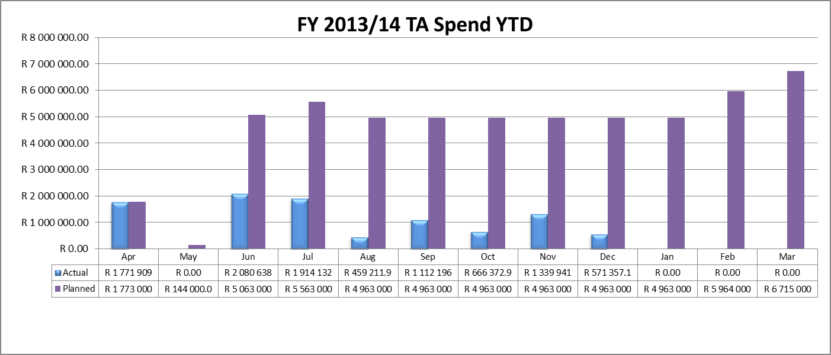
TA Spend

Slide 19
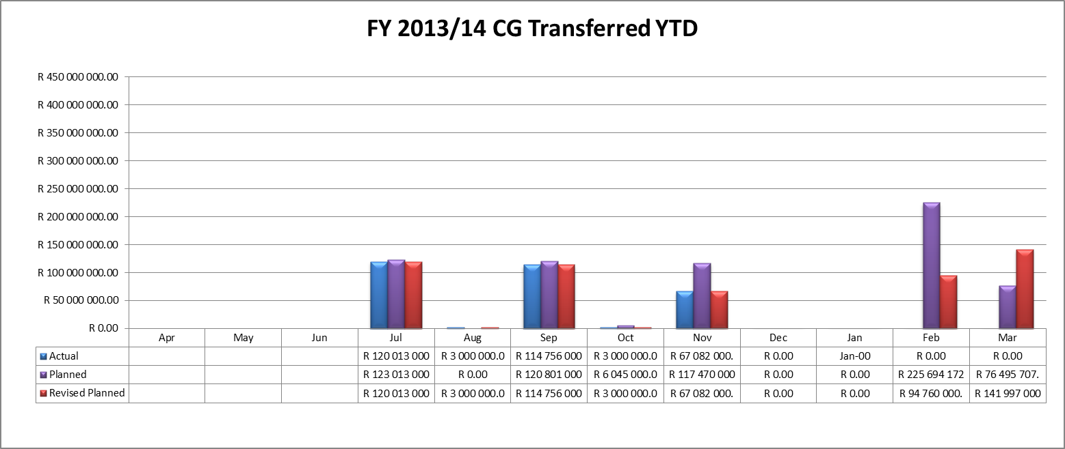
CG Spend

Slide 20
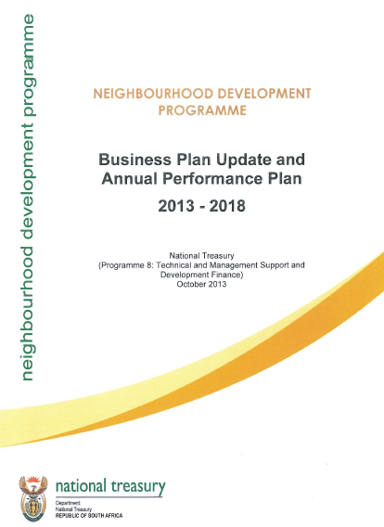
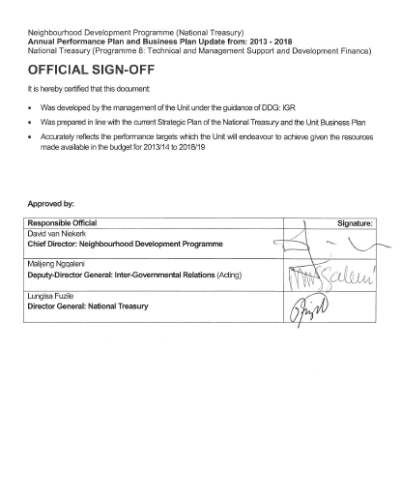

Slide 21
Private sector investment in targeted strategic locations
Planning
Implementation
Economic Development Services provided by 3rd parties
Urban Management
Capital project implementation
Finance
KM
KPI’s
National & Provincial Grants
Muni Budget
MFMA
SOE Budgets
Prov Budget
NDPG CG
NT Budget Process
DORA
Fiscal & Regulatory Instruments
MSA
IDP’s
Capital Project Pipeline
Capital Project pipeline on the Urban Network
Precinct Plans
Integration Zones
Urban Network Plan
SDF
SPLUMA
Approvals
Support
M&E
Approvals
Support
M&E
Toolkits
Stakeholder Management
NDPG TA

Slide 22
NDP’s Key Performance Indicators (KPI’s)
Planned
Actual
New Targets
KPI | TYPE | 2013/14 | 2013/14 | 2014/15 | 2015/16
Total number of executive engagements completed (Council Res / MOA) [1D] | Defined UN Per year Quarterly | 8 | 2 | 13 [includes all metros] | 18
Total number of approved / revised Urban Network Plans [2A] | BEPP / SDF Per year Quarterly | 4 | 0 | 8 [includes all metros] | 12
Total number of approved Precinct Plans (Urban Hubs) [3A&3B] | Per year Quarterly | 0 | 0 | 6 | 12
No of approved projects in implementation (as % of gazette) [4A-4F] | Per year Annual | 100% | 415% | 120% | 130%
Total number of Precincts (Urban Hubs) operational [5] | Per year Annual | 0 | 0 | 1 | 3
Total number of Partnerships concluded | Per year Annual | 1 | 0 | 3 | 5
Financial Leverage | Per year Annual | 1:1 | ? | 1:1.2 | 1:1.5

Slide 23
NDP’s Key Performance Indicators (Quarterly)
Open for discussion
Apr– Jun
Jul – Sep
Oct – Dec
Jan – Mar
Targets
KPI | TYPE | Q1 | Q2 | Q3 | Q4 | ANNUAL
Total number of executive engagements completed (Council Res / MOA) | Defined UN Per year Quarterly | 4 | 4 | 4 | 6 | 13 [includes all metros]
Total number of approved / revised Urban Network Plans (cumulative) | BEPP / SDF Per year Quarterly | 9 | 7 | 2 | - | 6 [includes all metros]
Total number of approved Precinct Plans (Urban Hubs) (cumulative) | Per year Quarterly | 0 | 0 | 6 | 2 | 6
No of approved projects in implementation (as % of gazette) | Per year Annual | - | - | - | 120% | 120%
Total number of Precincts (Urban Hubs) operational | Per year Annual |  |  |  | 1 | 1
Total number of Partnerships concluded | Per year Annual |  |  | 1 | 2 | 3
Financial Leverage | Per year Annual | - | - | - | - | 1:1.2
Urban Network Strategy Performance

Slide 24
Projects Administrator
(Lebo)
Interim
Structure
METRO | SECONDARY
 | Mogale City
Senior Admin Officer
(Suvashna)
Projects Manager
(Andile)
CoCT | Mbombela
NMBMM | Matlosana
 | Emfuleni
Planning PD
(Collins)
 | Emalahleni
 | Msunduzi
 | Newcastle
 | Sol Plaatje
 | Polokwane
Projects Manager
(Sifiso H)
Implementation PD
(Lee)
Projects Manager
(Liteboho)
COJ
COT
Ekurhuleni
Mangaung
Chief Director
Strategy & Knowledge
(Douglas)
Projects Manager
(Eugenie)
BCMM | Rustenberg
Ethekwini
Rural Projects Manager
(Sifiso M)
Finance
(Suzette)
Strategic Support Finance
(Mushumo)
Business Support
(Talita)
Team Assistant
(Neo)

Slide 25
RACI stands for…
“R” | Responsible | “The doer” | Position working on the activity
“A” | Accountable | “The buck stops here” | Position with yes/no authority
“C” | Consult | “In the loop” | Position involved prior to decision or action
“I” | Inform | “Keep in the picture” | Position that needs to know of the decision or action

Slide 26
RACI Stands for…
“R” | Responsible | The “doer” is the individual(s) who actually complete the task. The “doer” Is responsible for action/implementation. Responsibility can be shared. The degree of responsibility is determined by the individual with the “A”.
“A” | Accountable | The accountable person is the individual who is ultimately answerable for the activity or decision. This includes “yes” or “no” authority and veto power. Only one “A” can be assigned to an action.
“C” | Consult | The consult role is individual(s) (typically subject matter experts) to be consulted prior to a final decision or action. This is a predetermined need for two-way communication. Input from the designated position is required.
“I” | Inform | This is individual (s) who needs to be informed after a decision or action is taken. They may be required to take action as a result of the outcome. It is a one-way communication.

Slide 27
Collaborations
Stakeholders
Partners
Municipalities
Primary Activities
Project Implementation Planning & Construction
Urban Networks Planning
Precinct Planning
Precinct Management
Stakeholder Partnerships
Securing Leverage
Rural Handover
Support Activities
Grant Financial Management | Grant Agreement Management
Project Finance | Administration / Internal operations
Planning Finance | Records Management
Toolkits & Research | Internal Financial Management
Strategy, Knowledge Management & Communication | Operational Partnerships
Business Process & Systems | Directors Support

Slide 28
Director
KPA / Primary ACTIVITIES | KPI | 2014/15 TARGET | R | A | C | I
Urban Networks Initiation | Total number of executive engagements completed (Council Res / MOA) | 13 [includes all metros] | PM’s | Collins
Network Planning | Total number of approved / revised Urban Network Plans (cumulative) | 8 [includes all metros] | PM’s | Collins
Precinct Planning | Total number of approved Precinct Plans (Urban Hubs) (cumulative) | 6-8 | PM’s | Collins
Implementation | No of approved projects in construction (as % of gazette) | 120% | PM’s | Lee
Precinct Management | Total number of Precincts (Urban Hubs) operational | 1 | DC | DvN
Stakeholder Partnerships | Total number of Partnerships concluded | 3 | DC | DvN
Securing Leverage | Financial Leverage | 1:1.2 | DC | DvN
Rural Handover | Project implementation Monitoring Close outs | TBD | SM | ?
 | Support DRDLR in handover (project information, NDPG Operations Guide / MIS) | TBD | SM | ?
 | Establish Rural NDPG Grant |  | DC | DvN

Slide 29
Director
KPA / SUPPORT ACTIVITIES | KPI’s (not extensive) | R | A | C | I
Grant Financial Management | TA Payment Schedules and year end transfers Year end TA financial management processes CG Payment Schedules and year end transfers Year end CG financial management processes TA and CG payment requests management Budget submission Evaluation and reporting TA Audit | MM | SP
Project Finance | CG Benchmarking Assessment Adjusted gazette cash flows with spend monitoring Approved pipeline PPs cash flows Additional pipeline PPs to be identified Project close out monitoring Monthly web reporting monitoring | PM’s | Lee
Planning Finance | TA Benchmarking Assessment | PM’s | Collins
Toolkits & Research | Urban Networks Support Guide | DC | DvN | EN
Strategy, Knowledge Management & Communication | Strategic Planning & Business Planning NDP Case Studies NDP Website Updates NDP Stakeholder Strategy | DC | DvN
Business Process & Systems | HR Business Processes MIS | SP MM | DvN Suzette
Grant Agreement Management | Funding agreement / MOA management and coordination | PA | PM

Slide 30
Director
KPA / SUPPORT ACTIVITIES | KPI’s (not extensive) | R | A | C | I
Administration / Internal operations | Record, filing and document tracking & management Library coordination Office support functions (typing, faxing, answering) Travel coordination & logistics Support tender process coordination Leave coordination / reconciliation Stationary management Unit training and development coordination Certifications Recruitment support Staff contract management Service provider appointment plan / contract management | TvW SS NM | DvN | SP
Records Management | E-Registry management / coordination | TvW | SP
Int. Financial Management | Operational budget oversight and audit Internal expenditure and requisition coordination Procurement requests processing Invoice processing Unit telephone account reconciliation Demand planning / operational budget oversight S&T claims reconciliation | TvW SS NM | DvN | SP
Operational Partnerships | Establish PPF/TA in DBSA (GTAC and Intersite) CSP and ICDG | SP | DvN
Admin Support | Meeting logistics Minutes (actions) Ad-hoc requests Diary management S&T claims Secretarial support functions | SS NM | All

Slide 31
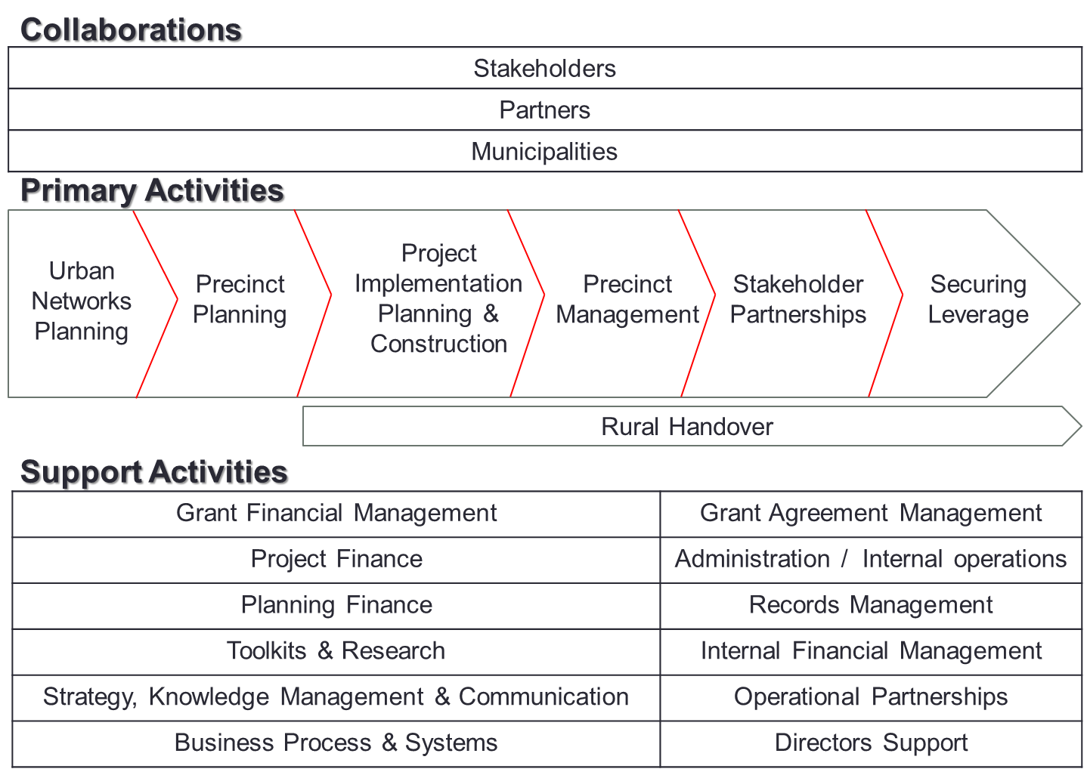

Slide 32
Core |  |  |  | Support
KPA | Outputs | Processes | Organisational | Grant Financial Management | Administration | Tools | Organisational
Establishment of Urban Networks Strategy | Council Resolution | Programme Initiation | Urban Planning | Envelope | Corporate Support Grant Agreement Management Records Management Internal Financial Management Business Process & Systems Directors Support | Toolkits &Research Project Finance Planning Finance | Strategy, Knowledge Management & Communication Operational Partnerships
Programme Planning | Network Plan per City Region | Network Planning | Urban Planning | TA Gazette & Payment Schedule
Precinct Plans* | Precinct Plan | Precinct Planning | Urban Planning
Precinct Management* | Precinct Management Plan | Precinct Management | Portfolio
Leverage* | Leverage Report |  | Portfolio
Project Delivery* | Project Plan (?) | Implementation | Project Implementation | CG Gazette & Payment Schedule
Rural Handover | Project implementation Monitoring Close outs | Implementation | Project Implementation | CG Gazette & Payment Schedule
 | Support DRDLR in handover (project information, NDPG Operations Guide / MIS) | Implementation | Project Implementation
 | Establish Rural NDPG Grant |  | Portfolio

Slide 33
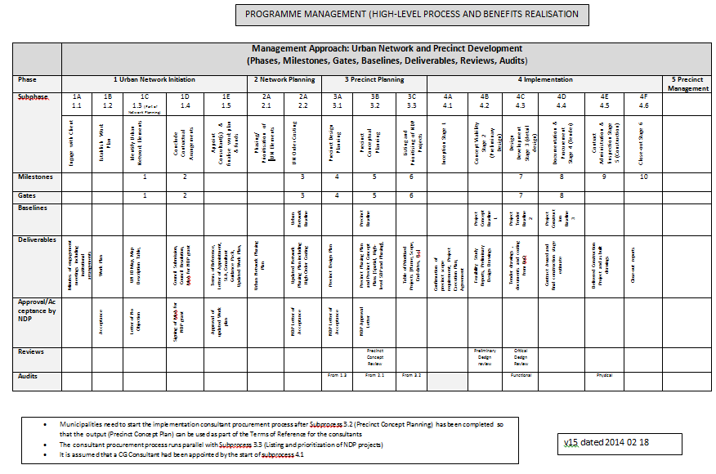

Slide 34
Approach
Apply RACI to all primary and support activities
Projects Directors and Project Managers to:
  Plan / schedule per municipality against:
    The Management Approach for Urban Network and Precinct Development
    Dates (per quarter)
Work @ tables
  1 director per table
  Discuss / share concerns
Populate draft performance agreements
Share / Present
Ensure alignment with Unit’s KPI

Slide 35
Session IV: Conclusion & Wrap Up

